Slide 1
어드밴텍
AIoT Developer Innoworks
공모전 예선 제안서
Team name

Slide 2

Summary
Name of Work | Kiwi EM Service
Application | Eco-friendly personal mobility sharing service
Features & Summary on Solutions | Eco-friendly personal mobility sharing service to address traffic jams and parking of difficulties Data collection system such as reduction of carbon emissions and measurement of fine dust in local districts through establishment of eco-friendly electric scooters sharing service system
Name of Team | Kiwi
Personal information | Team leader | Chang Hyungpil
 | Staff member | Seo Younseok
 | Staff member | Yun Taeil
 | Staff member | Lee Minyoung

Slide 3


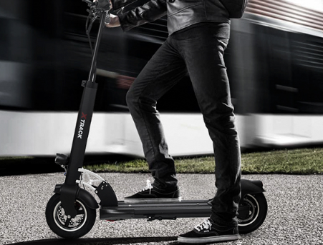


Solution Idea
Forecast of Personal Mobility
sales volume(unit)
200,000
75,000
▶ Plan
60,000
1
After establishing a rental system for students at Hansung University, the data are collected through pilot operation of it.
2016 year
2017 year
2022 year
< survey by the Korea Transportation Institute >
▶ Intention of the plan
▶ Benefit
According to a survey by the Korea Transportation Institute, the domestic personal mobility market will grow to 200,000 units by 2022.
1
It is available as a means of Short-distance transportation to solve traffic jams and parking difficulties.
2
Provide eco-friendly transportation to reduce CO2 and carbon emissions.

Slide 4

Solution Idea
Electric kickboard Sharing Service
▶ Short– distance Transportaion
1
It can solve traffic jams
and parking of difficulties.
▶ Shared-economy
2
Small mobility makes it easy to
reach your destination.
1
Community profits increase through
maximizing resource-utilization.
▶ Eco-friendly Mobility
2
We're less obsessed with owning
and side effects of consumer
society decrease.
1
Reduce carbon emissions.
2
Measure fine dust and also reducing it.
3
Mitigate traffic noise.
Eco-friendly personal mobility sharing service to address traffic jams and parking of difficulties

Slide 5
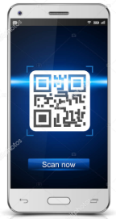
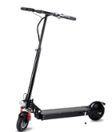

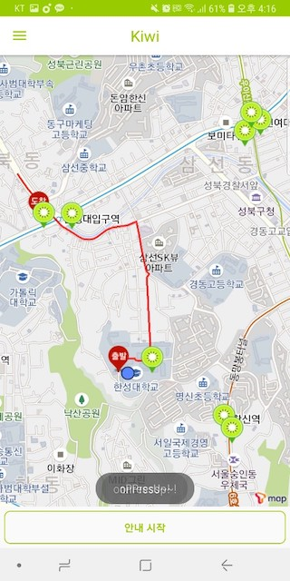


Solution Idea
Main function of Electric scooters rental system
▶ lock/unlock with QR code
Main
function
QR code recognition
- When using the electric scooter, lock/unlock with QR code recognition
Real-Time Payment System by Using APP
- Establishment of payment system by using APP
- Measuring and displaying charges according to real-time mileage
Bluetooth Communications
- Available after Bluetooth approval
GPS Communication
- Providing location of nearby electric scooter and park position
- Provides the real-time location of the electric scooter in motion
Applied technology
- Dashboards display CO2 savings through analysis of user distance
- Measurement of fine dust in the area where the scooter is located, displays measured quantity on the dashboard
- Administrator's dashboard to check state of scooter
▶Application
-Total mileage indicator
-Show CO2 savings
-Check the remaining
battery charge
▶ Bluetooth and GPS communication

Slide 6




App Development Plan
App Basic Function
WISE PaaS EdgeSense
Provides information on the electric rental
location of scooter and battery
Unlock the electric scooter with
QR code recognition
Bluetooth Communications
- check state of scooter
Pay for the amount of total time
Co2 savings in comparison to when used a car
WISE-PaaS/RMM
Show data stored in DB in dashboards
GPS - Position tracking of Electric scooter
Monitoring CO2 savings by analyzing
fine dust concentration
Managing the IoT equipment
IoT Module
WISE PaaS OTA
Bluetooth - check state of scooter
GPS - Position tracking of Electric scooter
Voltage measurement sensor - Measuring the remaining battery.
Speed Sensors / To measure speed
fine dust detection sensor / measuring fine dust concentration
IoT communication network / Transferring data to DB
IoT Module RemoteUpdate
Software RemoteUpdate
Dash Board RemoteUpdate

Slide 7
Go Together,
We Go Far and Grow Big

